Slide 1
Software Engineering Introduction
CSCI 5828: Foundations of Software Engineering
Lecture 05

Slide 2
What is Software Engineering?
Solving problems with software-based systems
Design and development of these systems require -
Analysis
decomposing large problems into smaller, understandable pieces
abstraction is the key
Synthesis
building large software systems from smaller building blocks
composition is challenging

Slide 3
What is Software Engineering?
To aid us in solving problems, we apply techniques and tools
Techniques - a formal “recipe” for accomplishing a goal that is typically independent of the tools used
automated builds, configuration management, software testing, etc.
Tools - an instrument or automated system for accomplishing something in a better way, where “better” can mean more efficient, more accurate, faster, etc.
gradle, git, jenkins, etc.

Slide 4
What is Software Engineering?
To aid us in solving problems, we apply
Procedures - a combination of tools and techniques that, in concert, produce a particular product
Paradigms - a particular philosophy or approach for building a product
Think: “cooking style”: may share procedures, tools, and techniques with other styles but apply them in different ways
Both approaches use similar things -
reqs., design, code, editors, compilers, etc.
But think about the problem in fundamentally different ways

Slide 5

A DAY IN THE LIFE Select Companies

Slide 6

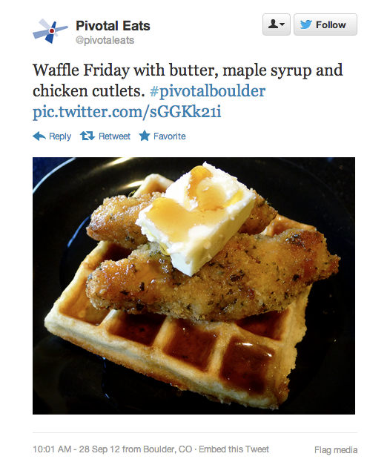

BREAKFAST

Slide 7
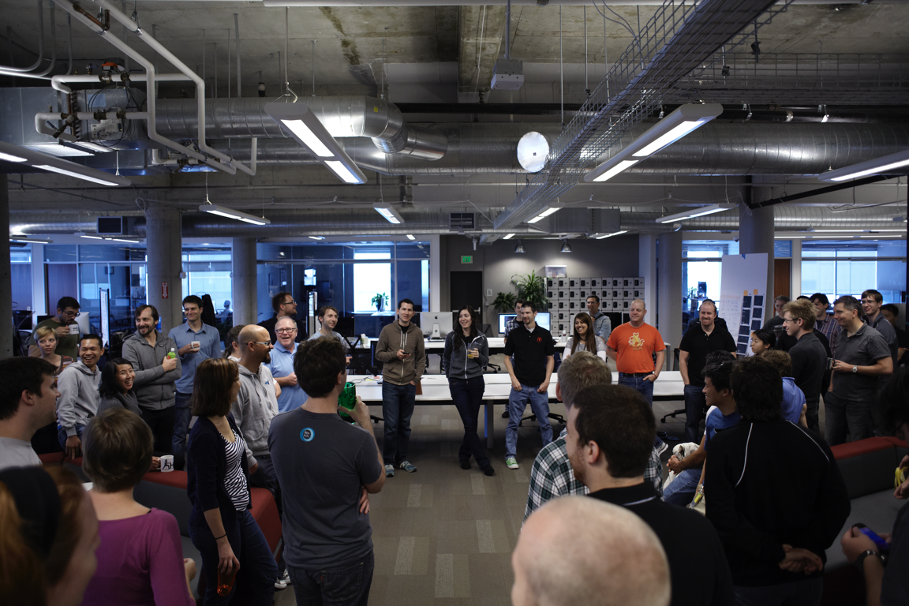
STAND-UP Full Team

Slide 8
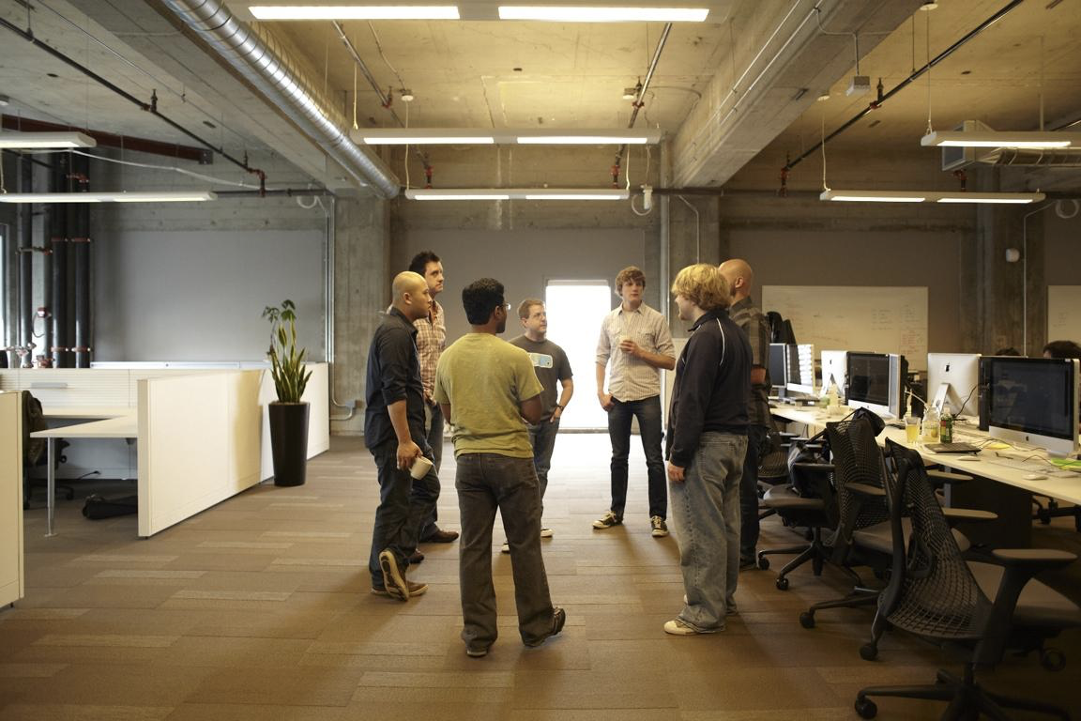
STAND AGAIN Product Team

Slide 9

GETTING WORK DONE

Slide 10

BREAKS

Slide 11

REPLENISH

Slide 12

SUSTAINABLE PACE
Consistent, predictable delivery is at a premium
Tired developers leave bugs
Tired developers leave
Short-term bursts of productivity cost more in the long-term

Slide 13

GETTING WORK DONE

Slide 14
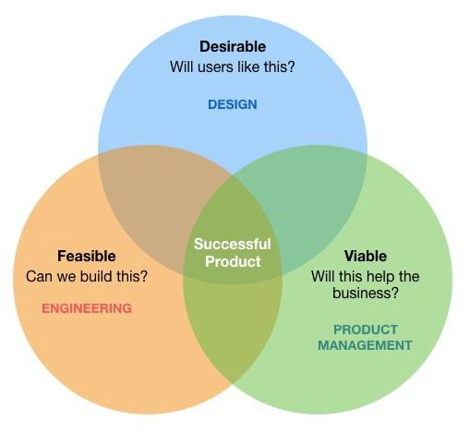
BALANCED TEAM
Balanced team, mission team or squad all similar
small, typically 4-8 people
co-located, or intermingled-then-remote
daily standups, weekly planning meetings
same hours
frequent cross-team rotation

Slide 15
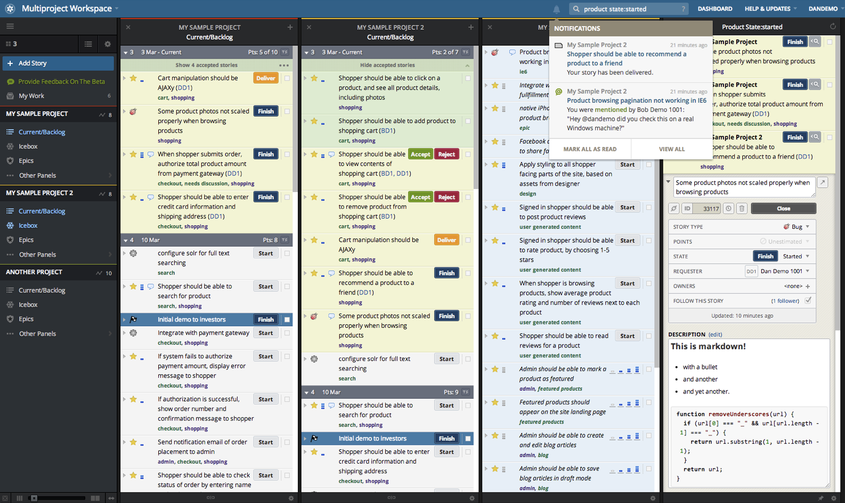
BUSINESS DRIVEN

Slide 16

IMMERSED PRODUCT MANAGER, OWNER
Ingrained, and a key part of, the team
Empowered to make decisions
Maintains prioritized backlog
Accepts/rejects stories continuously
Close collaboration with design/UX

Slide 17
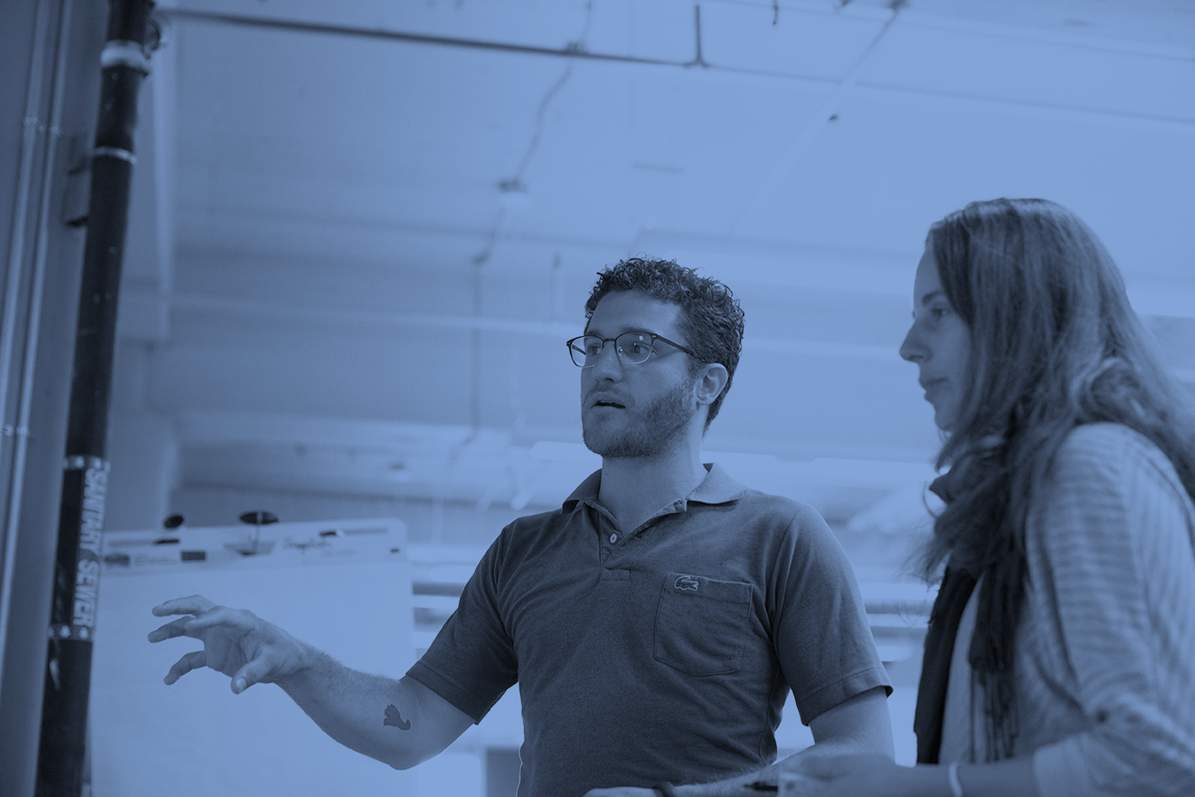
ITERATION PLANNING MEETING (IPM)
Backlog planning meeting
Typically weekly, on Monday or Tuesday
Notes:
Estimate size, derive duration

Slide 18
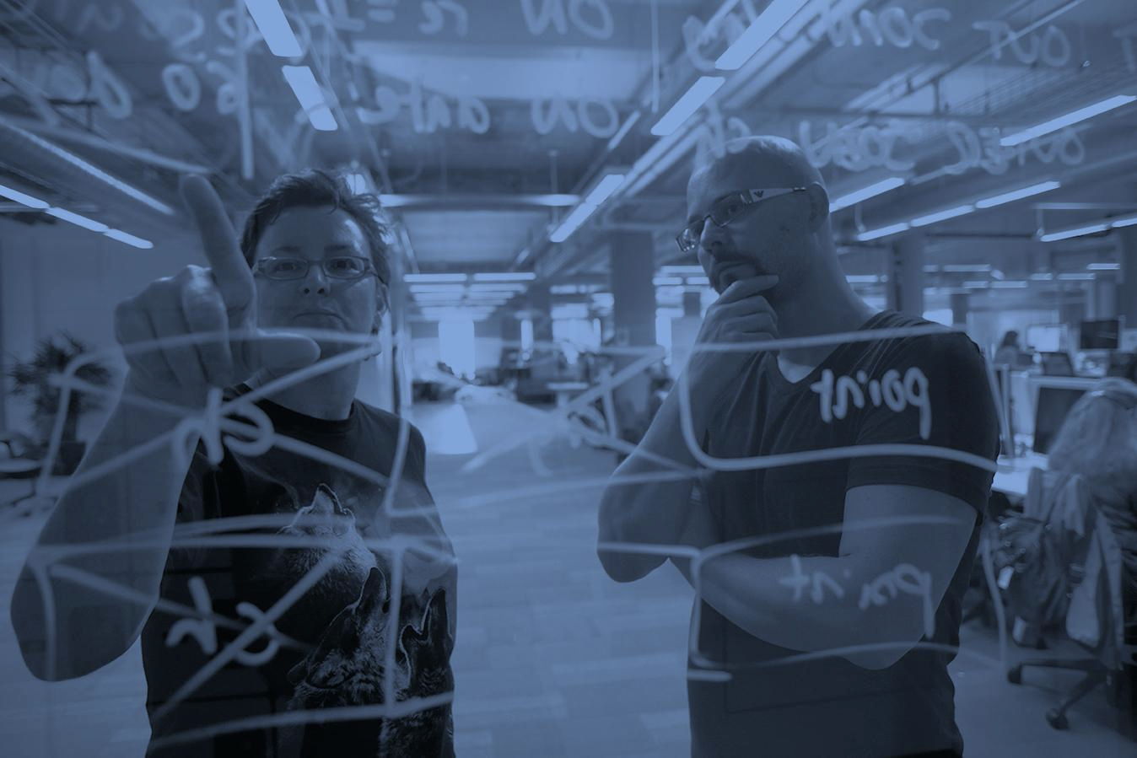
PAIR PROGRAMMING (XP)
All machines are communal
No laptops, phones
Ping pong pairing
Frequent pair rotation
Produt and design also pairs with developers!

Slide 19

PAIR PROGRAMMING (XP)
Higher quality code
Shares codebase knowledge quickly
Very high bus count
More focus
Greater discipline around other technical practices

Slide 20
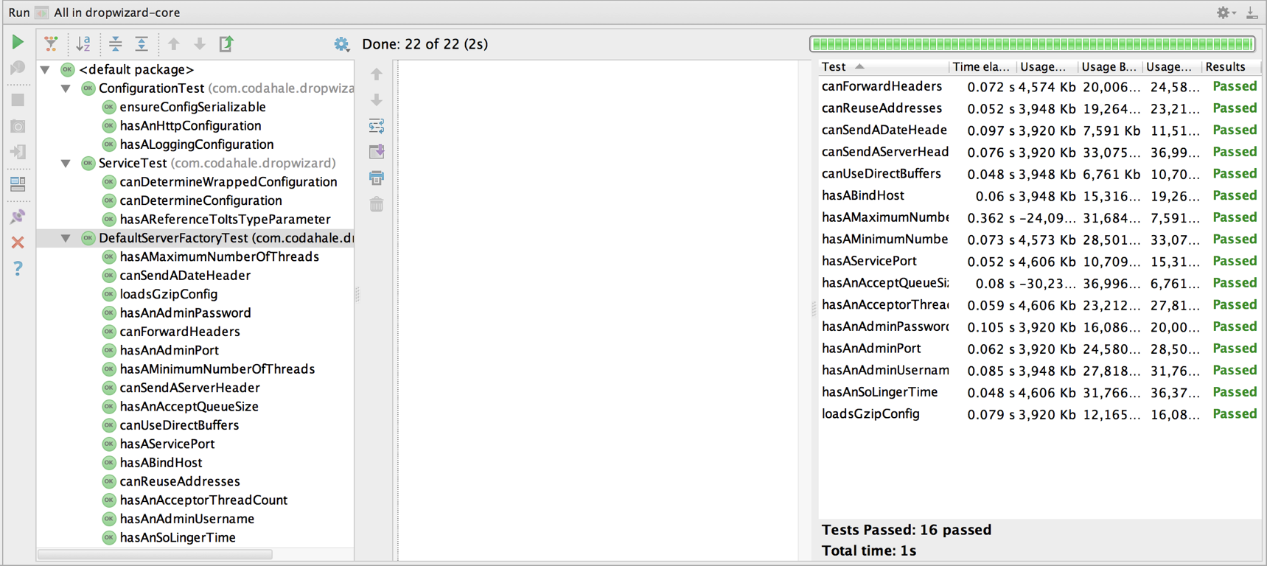
TEST DRIVE DEVELOPMENT
No production code written without a failing test
No code checked in without running tests
Focus on organization and readability of tests
Focus on keeping tests fast
Tests are for design

Slide 21
CONTINUOUS TESTING
Testing is a continuous process that should be performed at every stage of a software development process
During requirements gathering, for instance, we must continually query the user - “Did we get this right?”
Facilitated by an emphasis on iteration throughout a life cycle
at the end of each iteration
we check our results to see if what we built is meeting our requirements (specification)

Slide 22
TESTING THE SYSTEM
Unit Tests
Tests that cover low-level aspects of a system
For each module, does each operation perform as expected
For method foo(), we’d like to see another method testFoo()
Integration Tests
Tests that check that modules work together in combination
Most projects on schedule until they hit this point (MMM, Brooks)
All sorts of hidden assumptions are surfaced when code written by different developers are used in tandem
Lack of integration testing has led to spectacular failures (Mars Polar Lander)

Slide 23
TESTING THE SYSTEM
Acceptance Tests
Tests performed by the user (product owner) to check that the delivered system meets their needs
Developers will be working directly with product owners and then respond to problems as they arise

Slide 24
TESTING THE SYSTEM
Once we have code, we can perform three types of tests
White Box Testing
Since, we have access to most of the code, let’s make sure we are covering all aspects of the code: statements, branches, …
Grey Box Testing
Having a bit of insight into the architecture of the system, does it behave as predicted by its specification
Black Box Testing
Does the system behave as predicted by its specification

Slide 25
CODE COVERAGE
A criteria for knowing white box testing is “complete”
Statement coverage
write tests until all statements have been executed
Branch coverage (aka edge coverage)
write tests until each edge in a program’s control flow graph has been executed at least once (covers true/false conditions)
Condition coverage
like branch coverage but with more attention paid to the conditionals (if compound conditional, ensure that all combinations have been covered)

Slide 26
CODE COVERAGE
A criteria for knowing white box testing is “complete”
Path coverage
write tests until all paths in a program’s control flow graph have been executed multiple times as dictated by heuristics, e.g.,
for each loop, write a test case that executes the loop
zero times (skips the loop)
exactly one time
more than once (exact number depends on context)

Slide 27

REFACTORING
Code evolution
Incremental design towards patterns
It takes discipline, but pairing helps

Slide 28
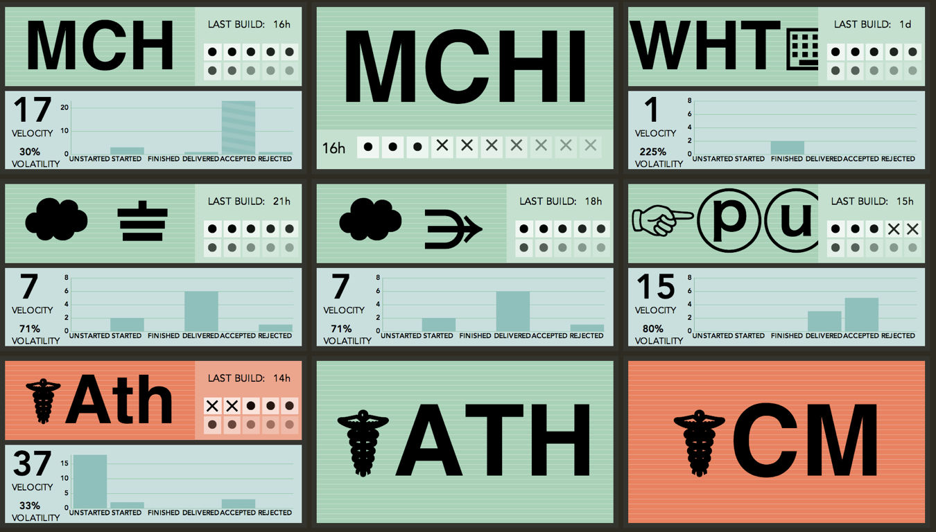
CONTINUOUS INTEGRATION
Critical to maintain constant cost of change
When to release is a business decision

Slide 29
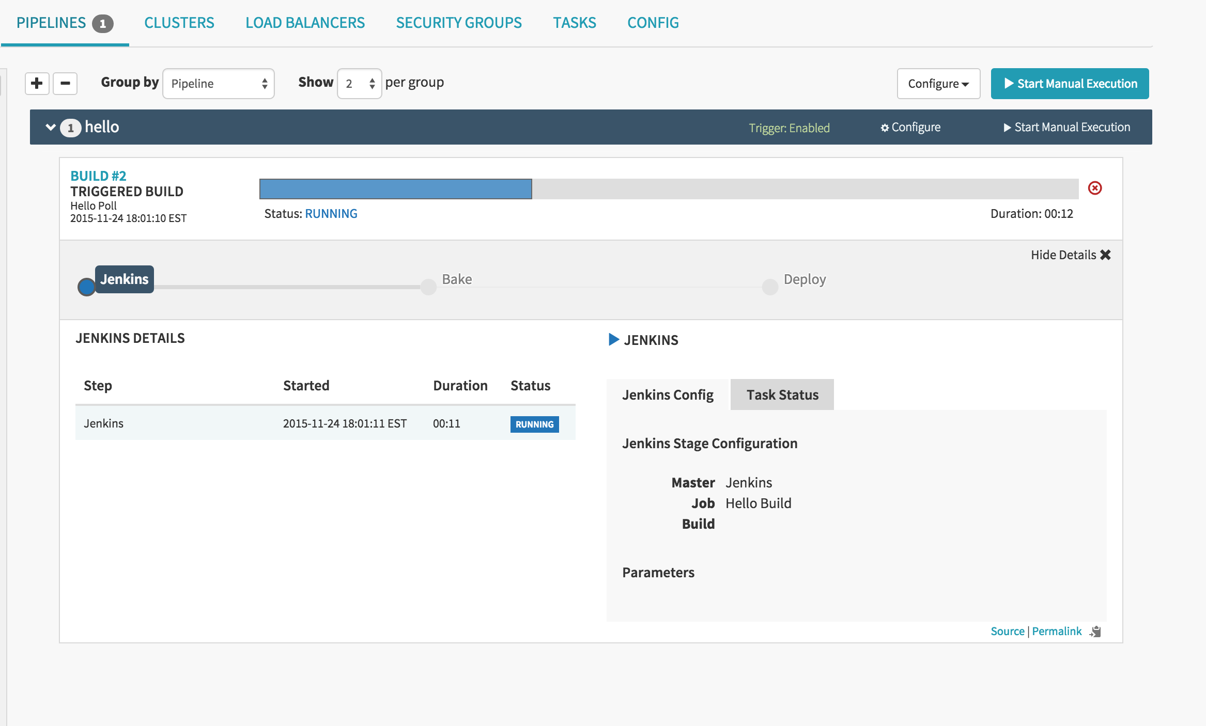
CONTINUOUS DELIVERY

Slide 30
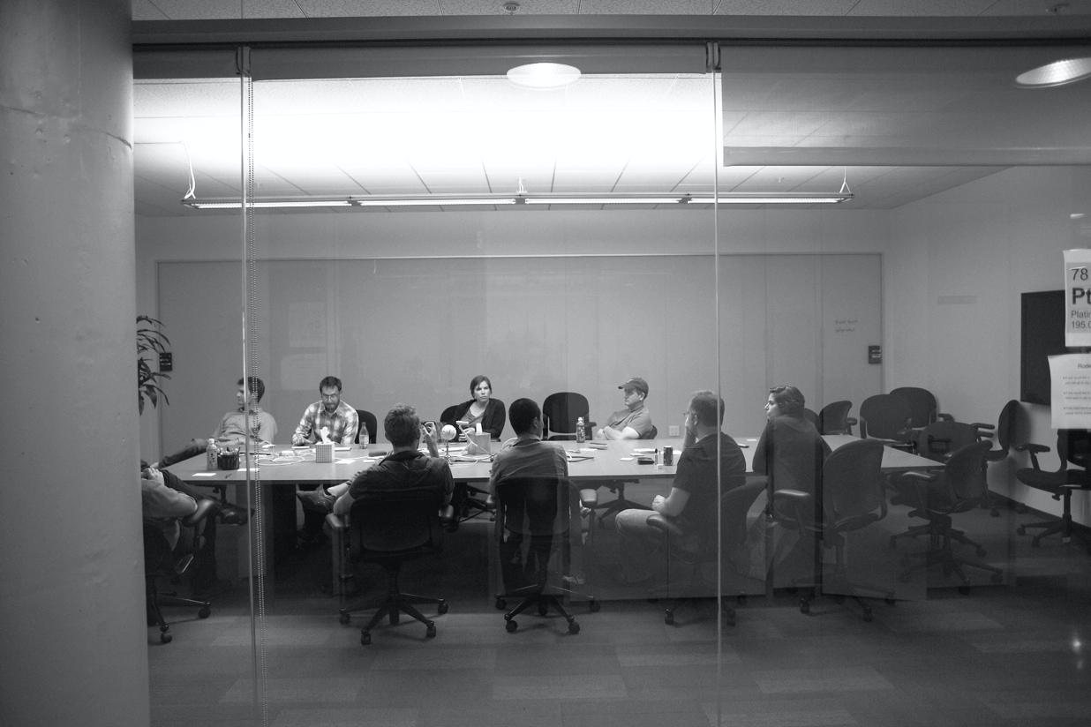



RETROSPECTIVES
reflect on what worked well, what was confusing, and what didn’t work well

Slide 31
Questions?

